Slide 1
Accumulators
accumulate information from prior recursive calls
three categories
preserve context from prior recursive calls
result so far
worklist
lecture 18 (previous)
this lecture

Slide 2
Roadmap
The next four lectures
forms of data: trees and graphs
recursion: structural non-tail and tail and generative
accumulators
path in data: previous, upper, lower, pnum, path, visited…
rsf (result so far)
path in tail recursion: visited, count, …
worklist
tandem worklist l18 l19 l20 l21

Slide 3
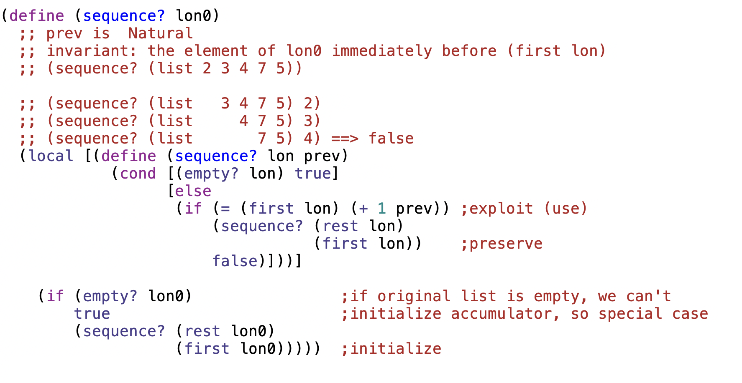

Slide 4
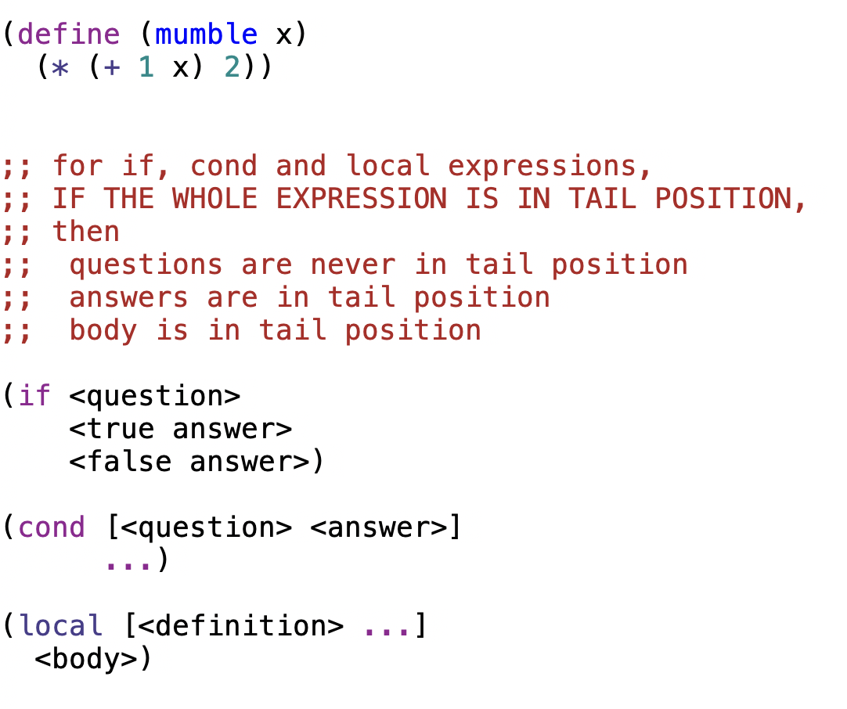
an expression is in tail-position when no surrounding expression in that function is waiting to operate on the value of the expression
tail position
not in tail position

Slide 5
definitions
an expression is in tail-position when no surrounding expression in that function is waiting to operate on the value of the expression
a function is tail-recursive when ALL recursive calls are in tail position
mutually-recursive functions are tail recursive when ALL recursive and mutually recursive calls are in tail position
in tail recursive functions, base cases produce the final result

Slide 6
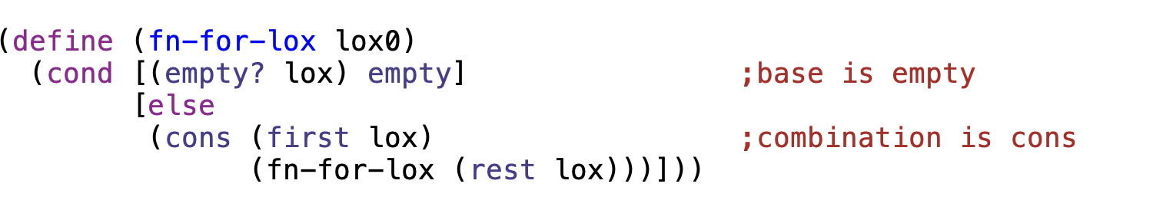
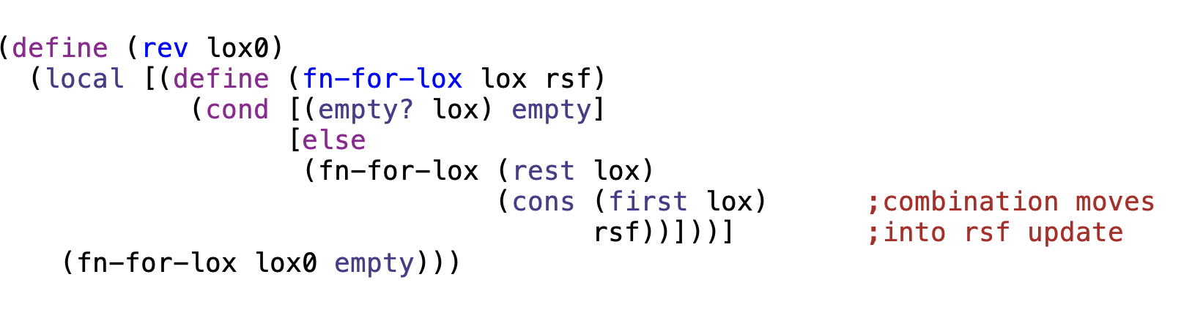
not in tail position
tail position

Slide 7
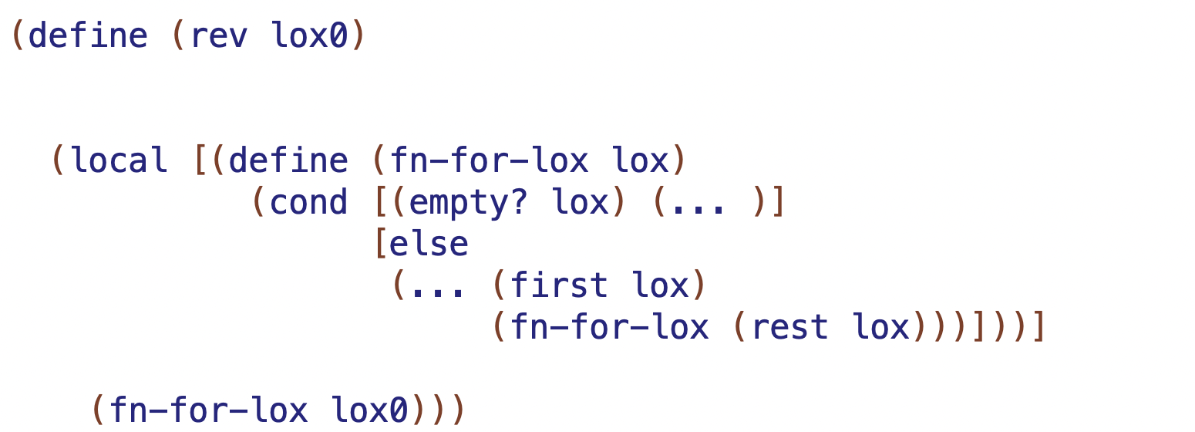
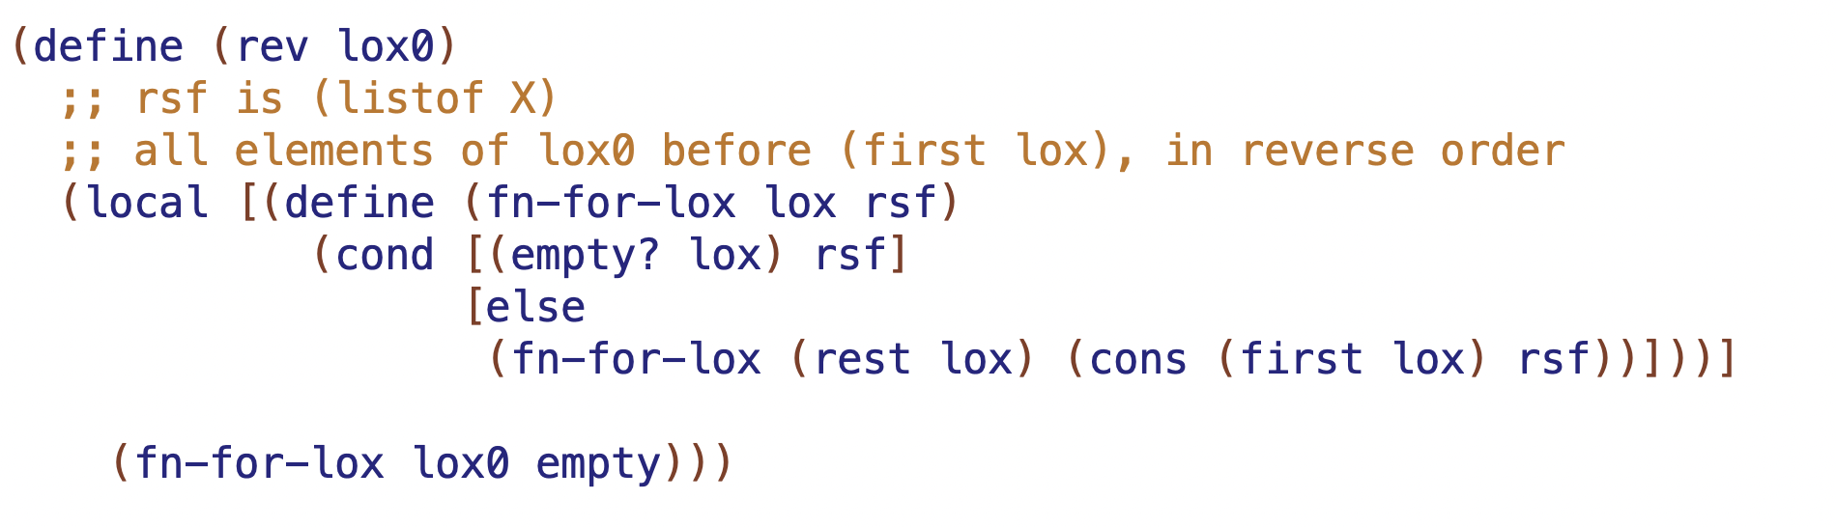
produce rsf at end
combination
initialize rsf (base case result)

Slide 8
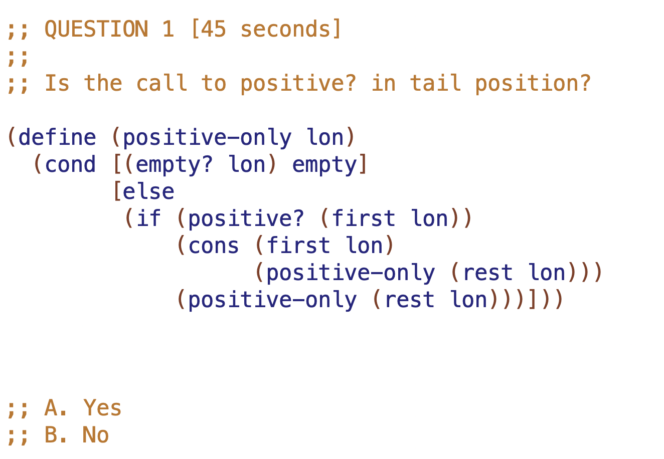

Slide 9
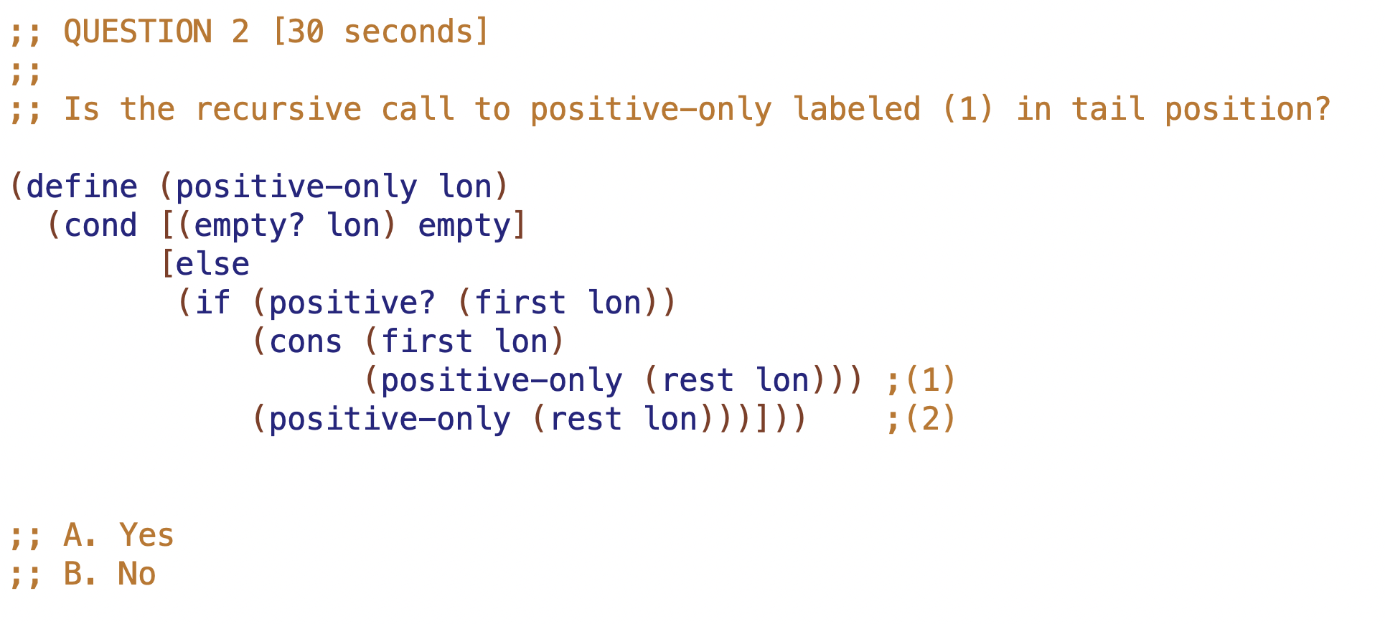

Slide 10
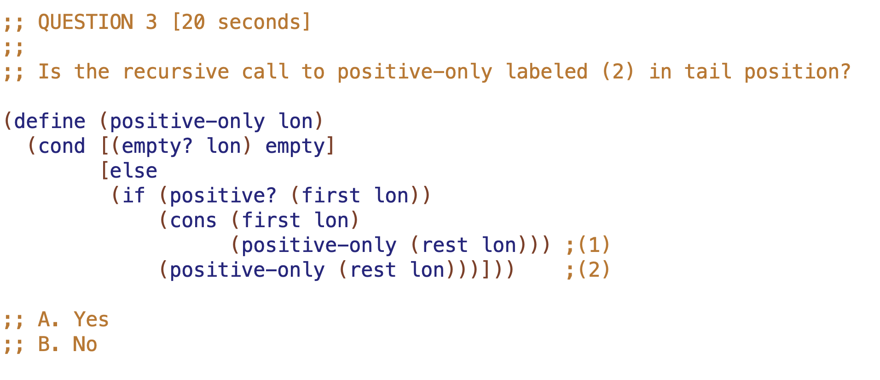

Slide 11
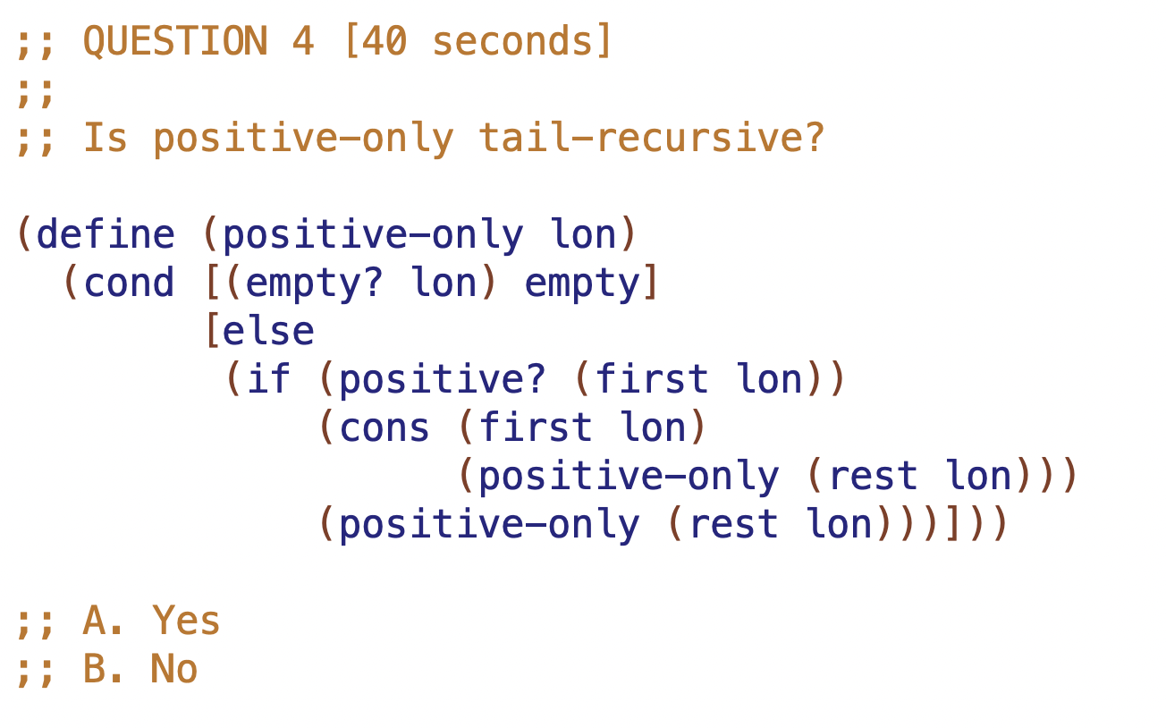

Slide 12
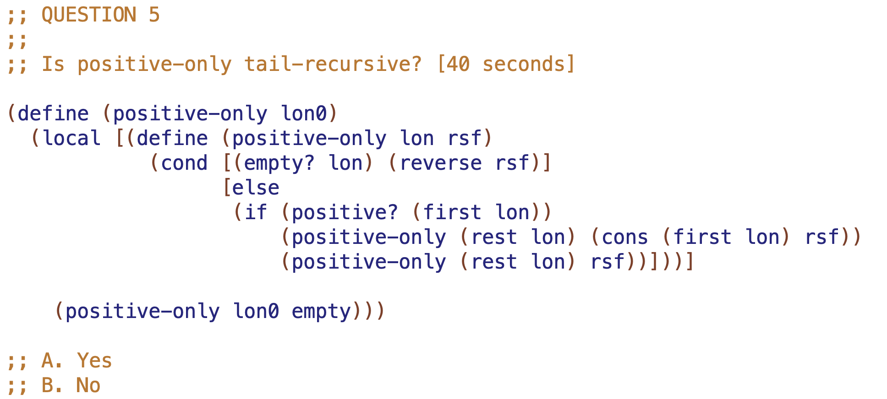

Slide 13
Example Tree
TOP1 - 10
M1 - 20
M2 - 40
L1 -30
L2 - 50
L3 - 60

Slide 14
TOP3 - 10
TOP1 - 10
TOP2 - 100
- 100
M1 - 20
M2 - 40
2 more Example Trees
L1 -30
L2 - 50
L3 - 60

Slide 15
NOTATION
fn-for-t is called with 1 tree
TOP1 - 10
fn-for-lot is called with list
M1 - 20
M2 - 40
L1 -30
L2 - 50
L3 - 60

Slide 16
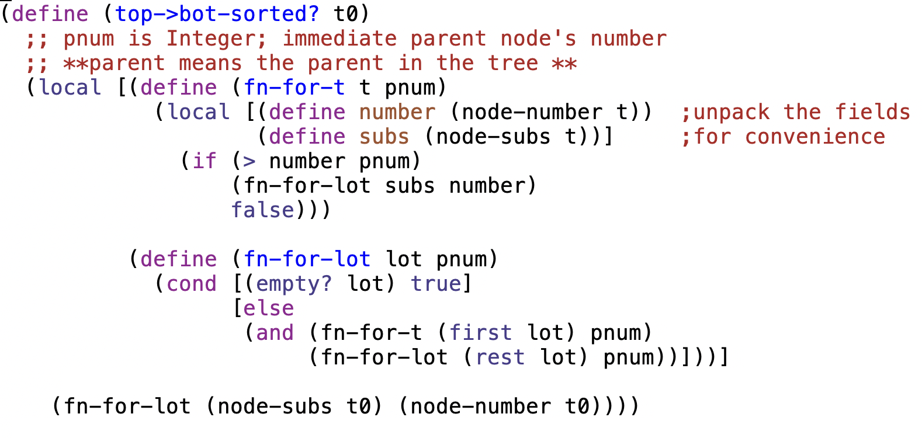

Slide 17
typical structural recursion
calls and results produced
TOP1 - 10
M1 - 20
M2 - 40
L1 -30
L2 - 50
L3 - 60
calls to fn-for-lot with empty

Slide 18
What’s in the past depends on the recursion
tail recursion means current call can have all the preceding context
→ it can produce answer directly
in a tree
ordinary recursion can carry context of what is above current call
but tail recursion is required to carry context of what is above and to the LEFT

Slide 19
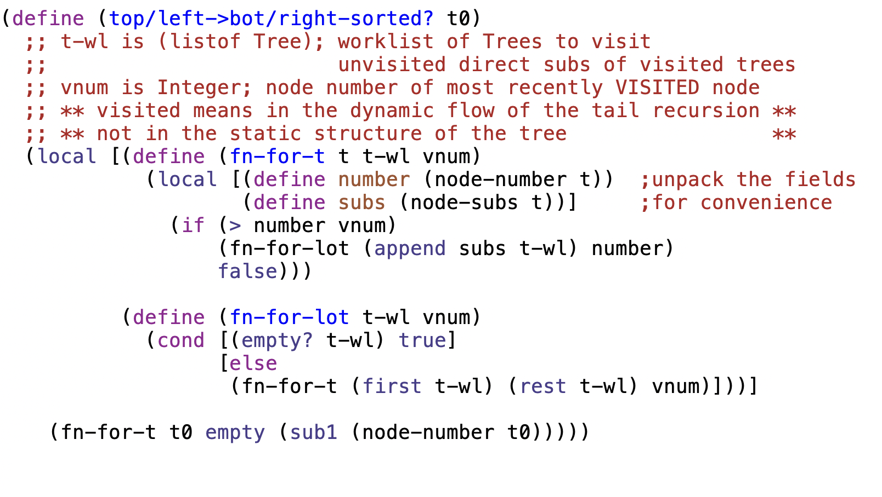

Slide 20
tail recursion with worklist
calls
tree worklist (tree-wl)
at fn-for-t and fn-for-lot
TOP1 - 10
M1 - 20
M2 - 40
L1 -30
L2 - 50
L3 - 60

